Slide 1
Emosic
Get music at your face tips
Presentation by:
Ajay Kundu (101503015)
Aditya Bisht (101553001)
Aarti Sharma (101683032)
Software Engineering
project
(USC503)

Slide 2
BACKGROUND
Universal Face Recognizer System
Human and Animal emotion examination
Enormous dataset from places in world
19th Century
20th Century
21st Century
1994: Facial Action Coding System
Human Face separated into 44 Action Units
Action Units can produce 7000 expressions
LBPH face Recognizer
Fisher face Recognizer
and more

Slide 3
What is Emosic
Emotion
Music
EMOSIC
It will recognise your real time facial emotion
Predict your current emotion.
Generate a music playlist in accordance to your emotion

Slide 4

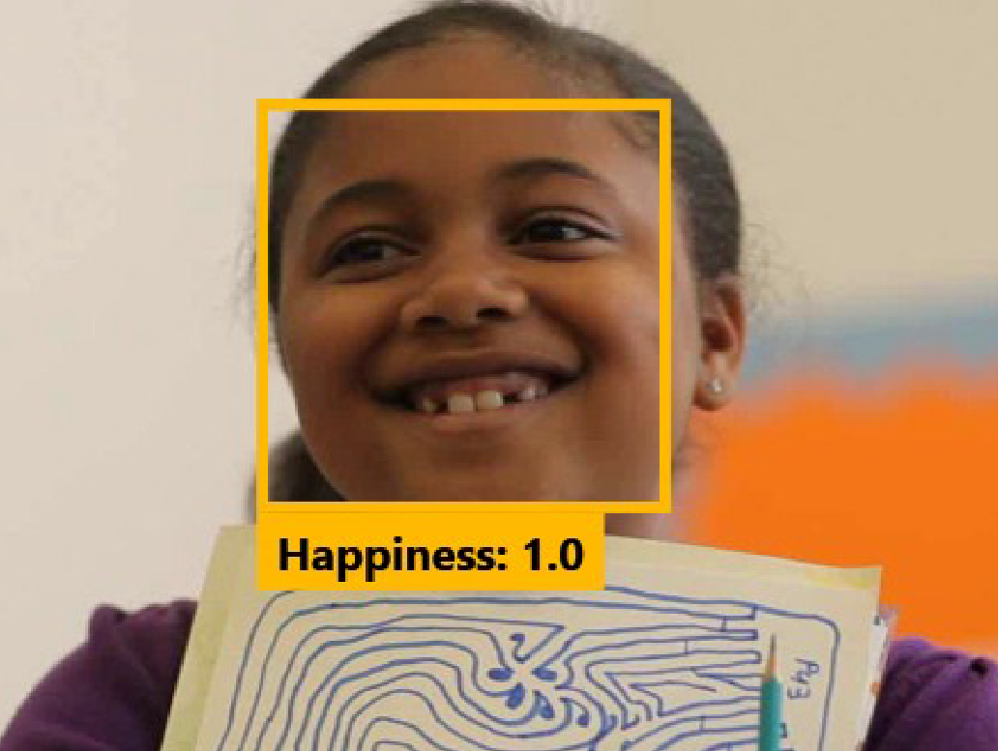
WORKFLOW
Face Detection
Using OpenCv
Training Using LBPH FaceRecognizer
Emotion Prediction
Database
Generated Music Playlist from Database Based on Emotion

Slide 5
Results
Number of Training Examples | Number of Testing Examples | Number of Emotional States | % Recognition Rate
5995 | 1433 | 4 | 76(approx.)

Slide 6

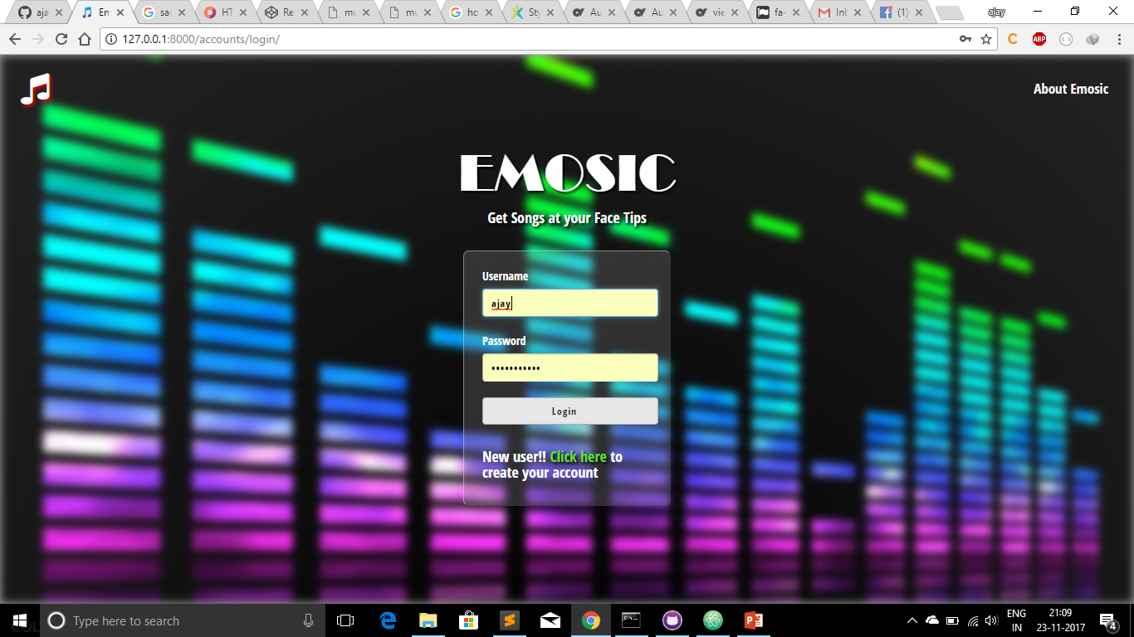
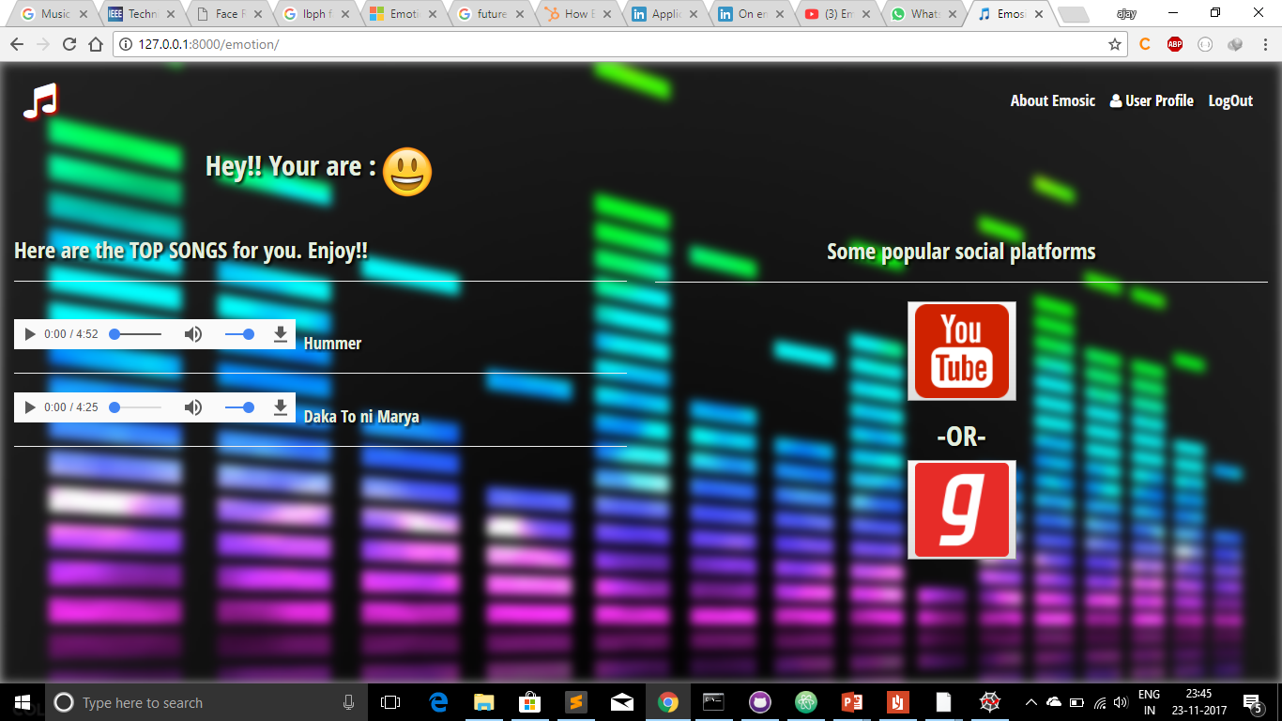
Screenshots

Slide 7



Future Application
Marketing – change marketing dynamically by getting person emotion
Home Automation – change lighting and Ask something
Help Robot to learn how to mimic human emotion

Slide 8

Thank you !!
?
any
https://github.com/ajaykundu/Emosic

